Slide 1
Gabe Newell
A man who can't count to three

Slide 2
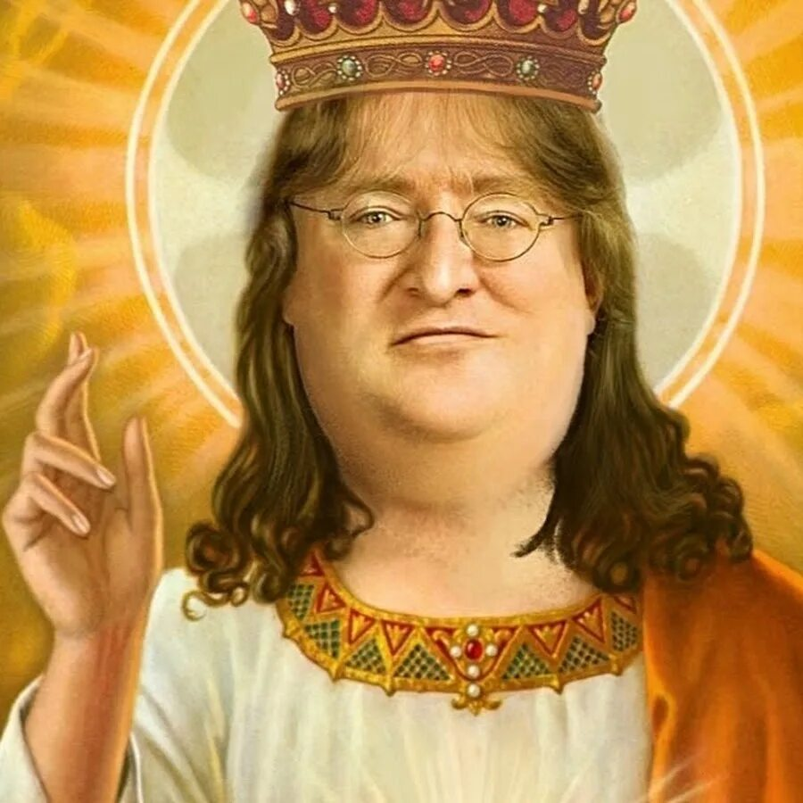
Forbes Billionaire Game Developer: The Gabe Newell Story
Gabe Newell is a simple American guy from Seattle, Washington, who came to his “American dream” quickly enough, and long before the creation of Half-Life and, moreover, Steam.

Slide 3
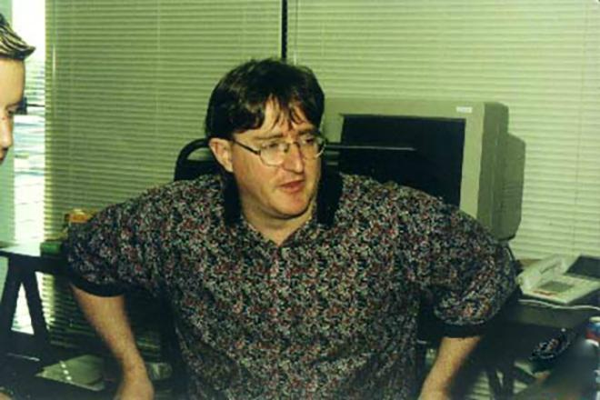
It was like this
As a child, Gabe began writing programs in ALGOL. He liked it so much that he decided to connect his life with programming and in 1980 he entered Harvard - he was 18 years old at the time. He studied at Harvard for only three years and, giving up on education, went to the growing Microsoft. Yes, yes, the Microsoft one.

Slide 4
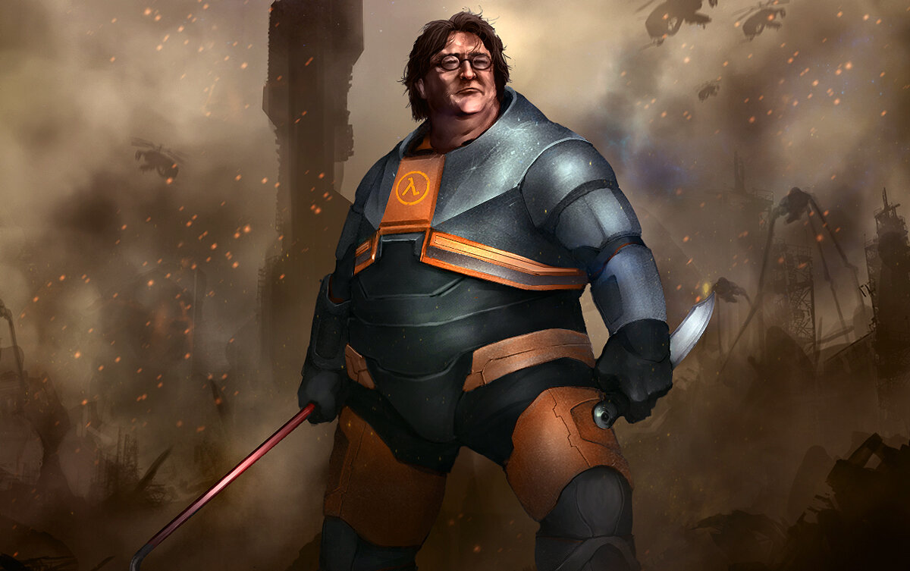
To make it clear
There was no Windows in 1983. Not only Windows 95, which is logical, but even Windows 1.0! More than that, Gabe Newell became one of the authors of Windows and produced the releases of versions 1.01, 1.02 and 1.03. Today, few people remember him as a Microsoft employee who worked on Windows, and this is what allowed him to make his first capital and even become A millionaire!

Slide 5
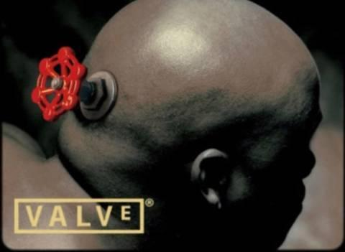
QUAKE
In the mid-90s, another talented programmer, Michael Abrash, left Microsoft. He decided to move to id Software to work on the game Quake, one of the most popular (so far) first-person shooters.
This inspired Newell, who also became passionately fond of video games. Therefore, in 1996, having persuaded his colleague Mike Harrington, he left Microsoft and created Valve to develop his first game, Half-Life, using the GoldSrc engine.

Slide 6
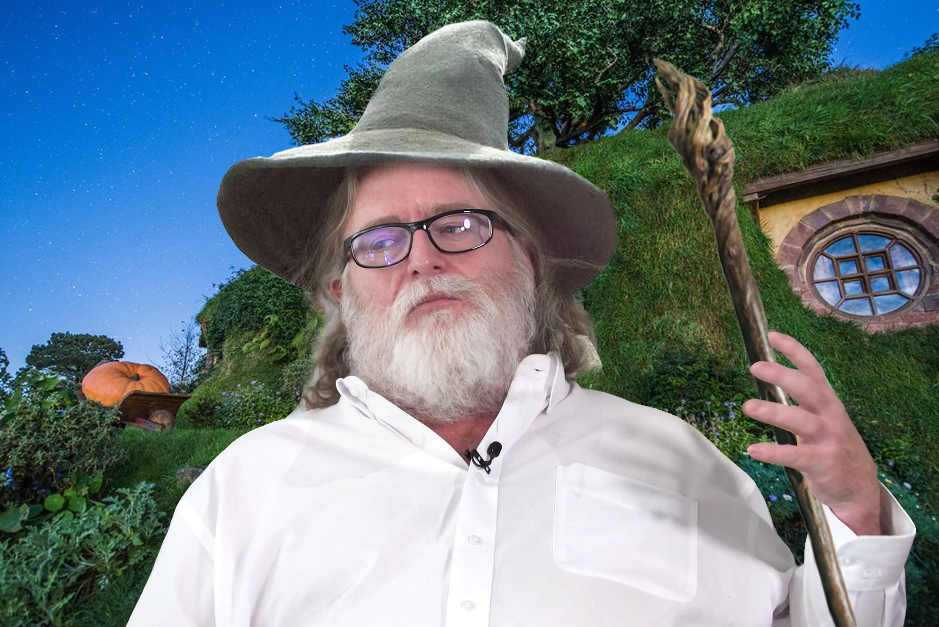
Half-life and Steam
The first part of Half-Life was published by Sierra, once a major publisher (known for its quests, first of all), which believed in the success of Valve's brainchild. Online games were just emerging back then, and there was no common understanding of how the service should be designed for player networking. Sierra's WON (World Opponent Network) was such a service, and it was also used in Half-Life.

